Slide 1


The AI Catalyst Hub: Empowering Businesses with ML
Welcome to the AI Catalyst Hub - your one-stop platform for powerful machine learning models that solve real-world problems.

Slide 2

What is AI Catalyst Hub ?
The AI Catalyst Hub: Empowering Businesses with ML is a B2B platform that creates and trains machine learning and deep learning models, providing small to mid-sized businesses and startups with tailored AI solutions. These models are designed to address specific industry needs, enabling companies to integrate advanced AI capabilities without the need for large-scale research or infrastructure.
The platform focuses on four key sectors: health, business, pollution, and agriculture. In health, it offers models for predictive analytics, disease diagnosis, and personalized treatment plans. For businesses, it provides solutions for customer segmentation, demand forecasting, and sales prediction. In pollution, the platform delivers AI tools to monitor and predict environmental data, while in agriculture, it offers models for crop yield prediction, pest detection, and soil analysis.
By focusing on these domains, The AI Catalyst Hub empowers companies to leverage cutting-edge AI technology for better decision-making, operational efficiency, and sustainability, helping businesses in diverse industries remain competitive in an increasingly data-driven world.

Slide 3
Unlocking the Power of MI Models
Categories:
Healthcare
Agriculture
Pollution
Business

Slide 4
Health Care: AI Solutions for Growth
AI in Healthcare Artificial Intelligence is transforming healthcare by enabling early detection and personalized treatment. It improves decision-making and reduces human error in clinical workflows.
Application in Eye, Heart, and Diabetes Diseases This project applies AI to detect eye diseases using Swin Transformer + Efficient Net, predict heart disease via logistic regression, and identify diabetes using Random Forest.
Impact and Outcome These models deliver high accuracy and consistency, helping doctors prioritize critical cases and enhance patient outcomes through timely diagnosis.

Slide 5
Unlocking the Power of ML Models
Healthcare
1️⃣ Eye Disease Classification
A hybrid deep learning model combining Swin Transformer and Efficient Net was developed to detect eye diseases from medical images .This model benefits from Efficient Net's efficient feature extraction and Swin Transformer’s ability to capture long-range dependencies.
2️⃣ Heart Disease Prediction
Logistic Regression was used to predict the likelihood of heart disease based on clinical parameters. The model demonstrated high interpretability and solid performance on structured health datasets.
3️⃣ Diabetes Prediction
Multiple machine learning models were tested for diabetes prediction using patient health data. Random Forest emerged as the best-performing model due to its high accuracy and robustness against overfitting.

Slide 6

1)Eye Disease Classification
Introduction
Problem
Early detection of eye diseases is crucial for preventing blindness and improving quality of life.
Objective
Develop a Transformer model to accurately classify various eye diseases.
Application
Assist ophthalmologists in diagnosis, improve patient care, and reduce preventable blindness.
Motivation
AI models can assist in early and accurate diagnosis, improving treatment outcomes.
Transformers Advantage
Transformers, especially Swin Transformers, enhance eye disease classification by capturing global dependencies through self-attention, improving feature extraction, robustness to variations, and generalization, making them superior to traditional CNNs.

Slide 7
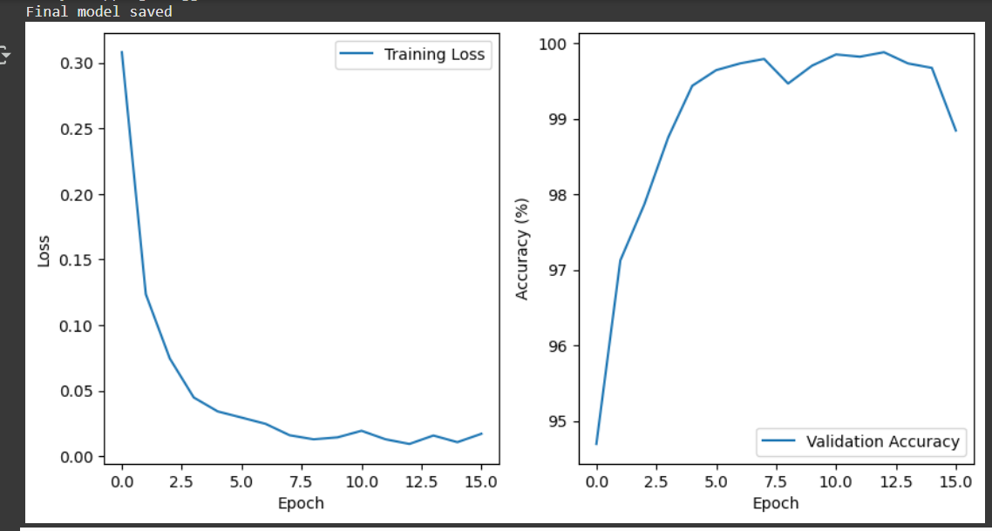
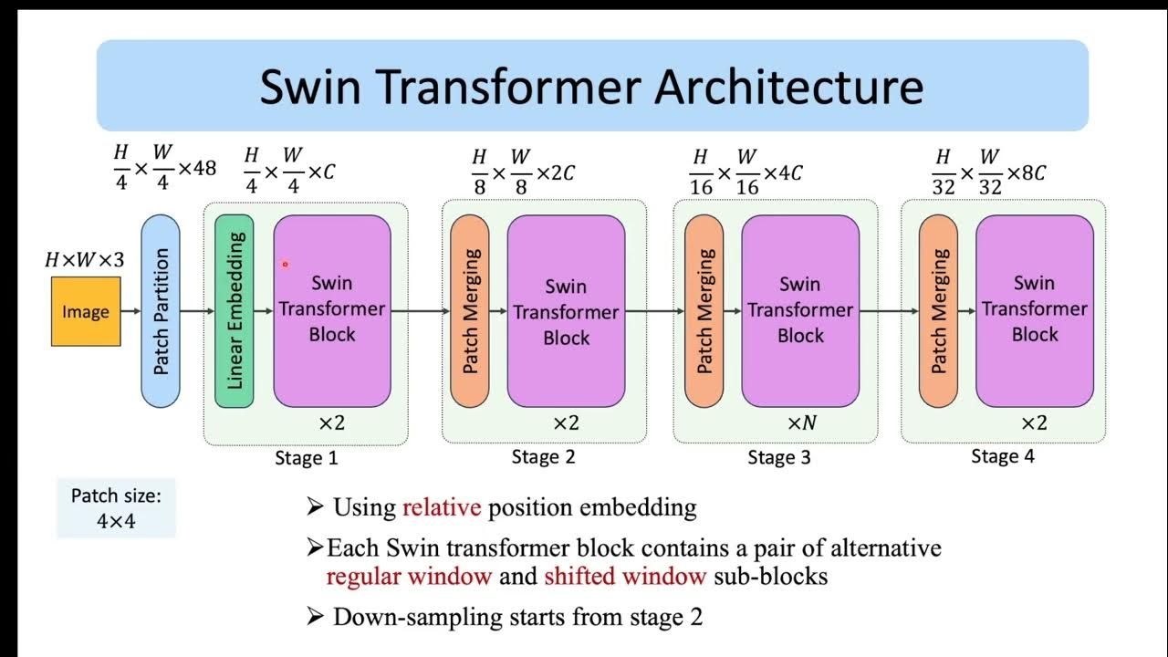
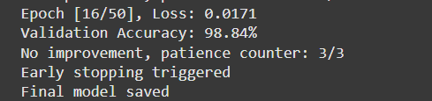
Results
Graphs depicting training and validation accuracy/loss curves.
Achieved high accuracy on the dataset.

Slide 8
2)Heart Disease Diagnosis
Introduction
Problem
Early detection of Heart diseases is crucial for preventing Heart attacks and improving quality of life.
Objective
Develop a Logistic Regression model to accurately classify healthy or Not.
Application
Assist Cardiologists in diagnosis, improve patient care, and reduce preventable attacks.
Motivation
AI models can assist in early and accurate diagnosis, improving treatment outcomes.
Approach
Try to find accuracy in all possible models and classifying using Voting Classifier

Slide 9
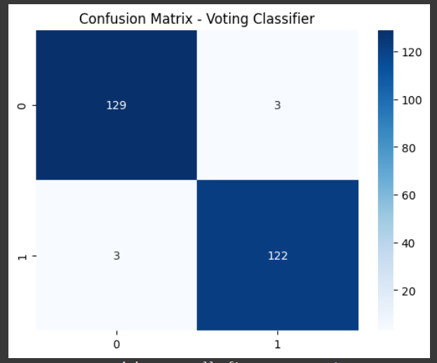
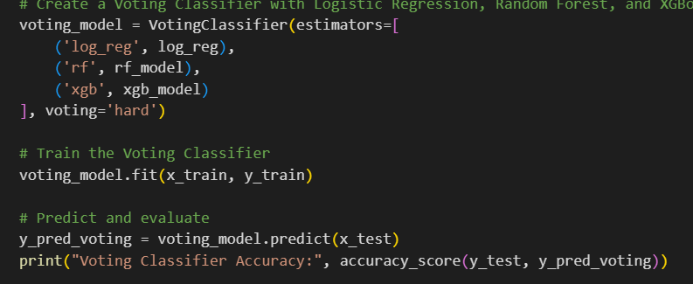

Results
Achieved high accuracy on the dataset.

Slide 10
3)Diabetes Prediction
Introduction
Problem
Detection of Diabetes is crucial for preventing severe attacks and improving quality of life.
Objective
Develop a Random forest Classifier to accurately classify healthy or Not.
Application
Assist Doctors in diagnosis, improve patient care, and reduce preventable attacks.
Motivation
AI models can assist in early and accurate diagnosis, improving treatment outcomes.
ML Approaches
Predicting using Random Forest Classifier

Slide 11
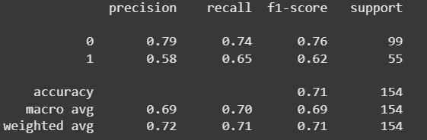
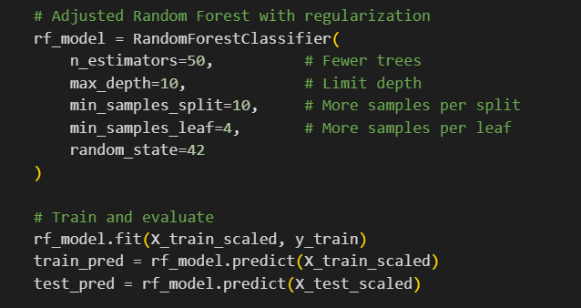

Results

Slide 12
Agriculture: AI Solutions for Growth
AI enhances crop prediction, analyzing data to forecast yields and suggest optimal crops. Soil quality assessment uses AI-driven sensors to evaluate nutrients and moisture for better farming decisions.
Crop quality analysis employs computer vision to detect diseases and classify produce. Weather prediction leverages AI models for accurate climate forecasts, helping farmers plan efficiently.
Additionally, AI helps in optimizing resource usage, reducing losses, and ensuring sustainable agricultural practices. AI-driven automation in farming increases productivity, while data-driven insights support better decision-making, contributing to overall agricultural growth.

Slide 13
Crop Recommendation System
Problem Statement
Predict the most suitable crop based on soil nutrients, temperature, humidity, rainfall, and pH to help farmers make data-driven decisions.
Model Used
K-Nearest Neighbors (KNN), chosen for its ability to handle multi-class classification and adaptability to different datasets.
Model Architecture
Input Features: N, P, K, Temperature, Humidity, Rainfall, pH
Steps: Data preprocessing → Model training → Prediction
Accuracy: 98.81 %

Slide 14
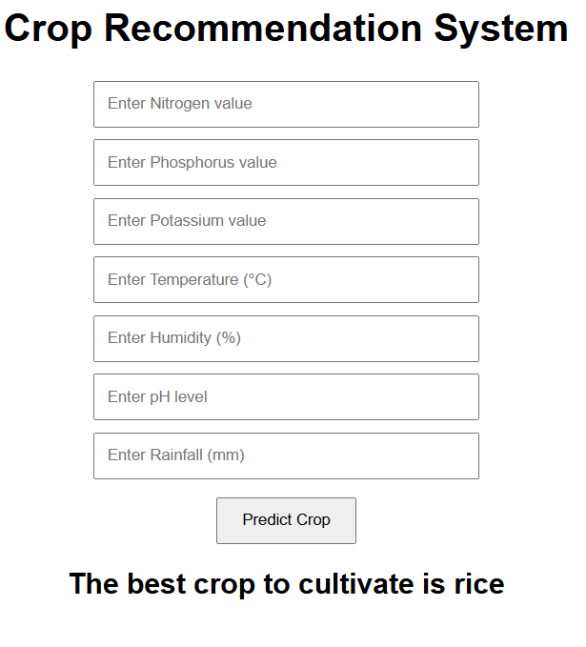
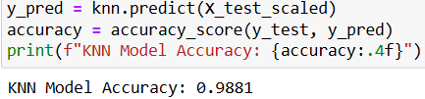
Real-Life Uses
Precision Farming: Helps farmers choose the best crops.
Smart Agriculture: Enables automated decision-making.
Government & Research: Assists in policymaking and agricultural studies.
Sustainability: Reduces crop failure risks and boosts productivity.

Slide 15
Soil Quality Prediction
Problem Statement:
This project aims to predict soil quality based on various nutrient and chemical properties, helping farmers make data-driven decisions for better soil management.
Model Used:
The XGBoost (Extreme Gradient Boosting) classifier is used for its efficiency, speed, and high predictive accuracy in structured data classification problems.
Model Architecture:
Input Features: Nitrogen (N), Phosphorus (P), Potassium (K), pH, EC, OC, S, Zn, Fe, Cu, Mn, B.
Preprocessing: Data normalization and handling imbalanced classes.
Model Training: Hyperparameter tuning for optimal performance.
Output: Predicts soil quality category (e.g., 0 : High, 1 : Medium, 2 : Low).
Accuracy: 86.36%

Slide 16
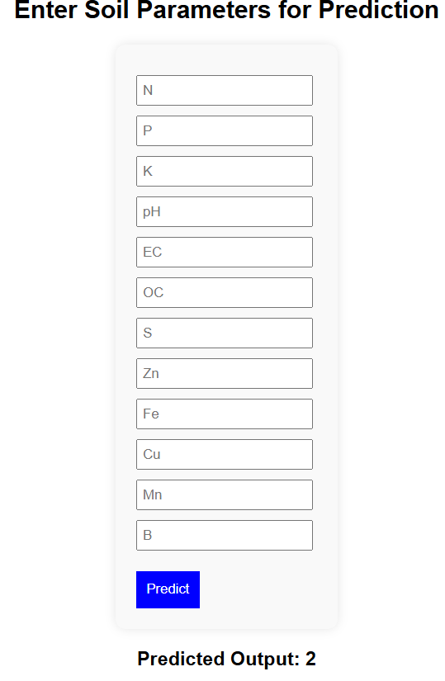

Real-World Applications:
Precision Agriculture: Helps farmers optimize fertilizer use and improve crop yield.
IoT-based Soil Monitoring: Can be integrated with IoT sensors for real-time soil analysis.
Smart Farming Apps: Assists in decision-making by recommending soil treatments.
Agricultural Research: Supports researchers in studying soil nutrient deficiencies.

Slide 17
Crop Quality Prediction
Problem Statement
This project aims to automate the quality classification of crops using CNN. Manually assessing crop quality can be subjective and time-consuming, so this model provides a consistent and accurate method to classify crops into 90, 70, and 60 quality labels based on images.
Model Used & Architecture
A Convolutional Neural Network (CNN) with the following layers:
Conv2D + ReLU for feature extraction
MaxPooling2D for dimensionality reduction
Dropout to prevent overfitting
Fully connected layers + SoftMax for classification Trained using Adam optimizer and categorical cross-entropy loss.
Accuracy
The model achieves ~85-90% accuracy, depending on optimizations like data augmentation and hyperparameter tuning.

Slide 18
CNN Model Architecture
Global
Average
pooling
Dense
256
Dense
128
Conv2d(16)
maxpooling2d
Conv2d(32)
Max pooling2d
Conv2d(64)
maxpooling2d
Conv2d(128)
maxpooling2d
Feature Extraction
Output
Input Image
Activation-ReLu
Output: Quality-
Crop-

Slide 19
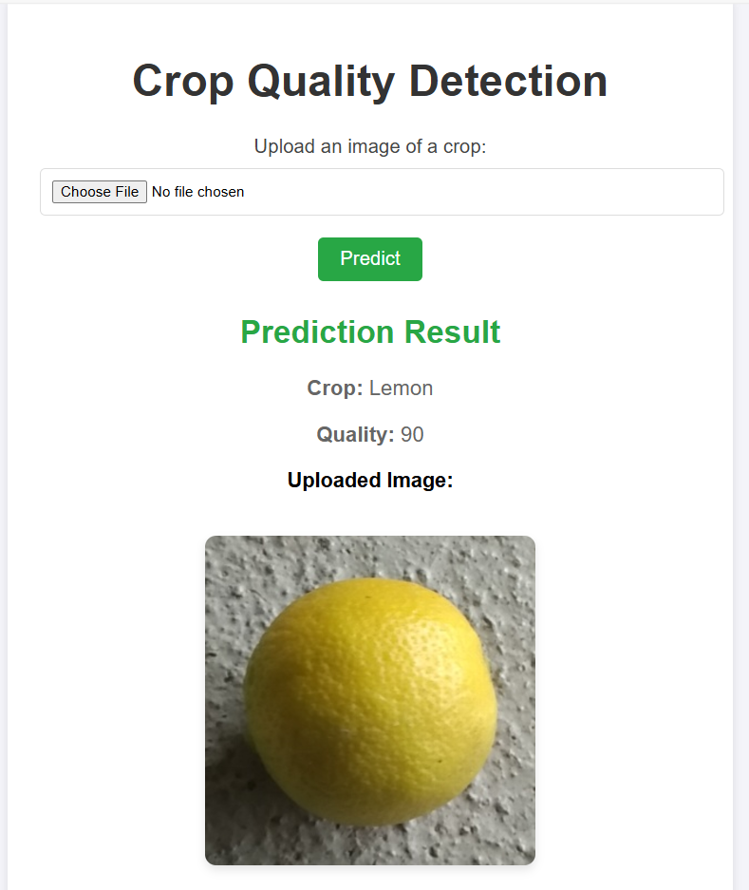
Real-Life Applications
Automated crop quality classification for farmers and agricultural research.
Sorting and grading crops based on predefined quality standards.
Assisting in agricultural automation for better crop management.
Reducing manual inspection efforts in large-scale farming.
Integration with smart farming systems for real-time monitoring.

Slide 20
Business: AI Solutions for Growth
AI Solutions for Growth in The AI Catalyst Hub: Empowering Businesses with ML focuses on leveraging artificial intelligence to drive business success through smarter decision-making and improved customer insights. AI solutions can empower businesses to enhance their marketing strategies by identifying key customer segments. By analyzing large datasets, businesses can uncover hidden patterns and trends.
AI also plays a crucial role in enhancing customer experience and satisfaction. Businesses can use AI to automate and streamline customer interactions, providing personalized recommendations and responses based on individual preferences. This level of personalization helps improve customer retention and loyalty.
Moreover, AI solutions can support businesses in their efforts to reduce churn and boost profitability. By predicting customer behavior and identifying at-risk clients, companies can take proactive measures. Overall, AI offers businesses the tools to optimize current operations and unlock new growth opportunities.

Slide 21
Customer Segmentation
Problem Statement
The goal is to segment customers into distinct groups based on their behaviors or characteristics, helping businesses tailor marketing strategies and improve customer engagement.
Model Used
K Means Clustering is employed to divide customers into K distinct clusters based on feature similarity.
Model Architecture
Preprocessing:Clean data, normalize features, and encode categories.
Elbow Method: Plot WCSS vs. K to find the optimal number of clusters.
KMeans Clustering : Fit the model with chosen K and assign customers to clusters.
Result : Distinct customer segments for business insights.

Slide 22
Real-World Applications of Customer Segmentation using K Means
Helps businesses run targeted marketing campaigns for different customer groups.
Improves customer retention by identifying loyal and at-risk segments.
Assists in personalized product recommendations based on segment behavior.
Optimizes pricing and discount strategies for specific customer clusters.
Enhances customer support by tailoring services to each segment's needs.

Slide 23
Customer Review Sentiment Analysis
Problem Statement
The goal is to analyze customer reviews and classify them as positive, negative, or neutral. This helps businesses understand customer sentiment, improve products or services, and make data-driven decisions based on feedback.
Model Used
Distil BERT, a lightweight and faster version of BERT, is used for sentiment analysis. It retains most of BERT’s accuracy while being more efficient for real-time inference.
Model Architecture
Preprocessing: Clean text (remove stop words, special characters) and tokenize using the Distil BERT tokenizer.
Model Input: Convert tokens into input IDs and attention masks suitable for the transformer model.
Model: Feed inputs to the pretrained Distil BERT model followed by a classification head (usually a dense layer) to predict sentiment.
Output: Sentiment label (positive, negative, or neutral) for each review.

Slide 24
Real-World Applications of Customer Review Sentiment Analysis
Understand customer opinions to improve products and services.
Monitor brand reputation across online platforms.
Automate review moderation by flagging negative or harmful feedback.
Guide business strategy based on overall customer sentiment trends.
Enhance customer support by prioritizing and addressing negative reviews quickly.

Slide 25
Customer Churn Prediction
Problem Statement
The objective is to predict whether a customer is likely to stop using a product or service (churn) based on their past behavior and interactions. This helps businesses take proactive steps to retain valuable customers.
Model Used
Random Forest Classifier, an ensemble learning method, is used for its robustness, accuracy, and ability to handle both numerical and categorical data effectively.
Model Architecture
Preprocessing: Clean the dataset, handle missing values, encode categorical features, and normalize numerical data.
Feature Selection: Choose relevant features like usage frequency, complaints, tenure, and customer satisfaction.
Random Forest: Train multiple decision trees on random subsets of data and aggregate their outputs (majority voting) for final prediction.
Output: Predicts if a customer will churn (yes/no), helping businesses act in advance.

Slide 26
Real-World Applications of Customer Churn Prediction
Helps telecom and subscription companies reduce churn by identifying at-risk customers.
Enables targeted retention campaigns to retain high-value clients.
Optimizes customer service by prioritizing support for likely-to-churn users.
Informs product or pricing changes based on churn patterns.
Improves long-term revenue by maintaining a loyal customer base.

Slide 27
Pollution: AI Solutions for Growth
AI for Pollution Monitoring Artificial Intelligence enables real-time monitoring of air, water, and noise pollution using sensor data and satellite imagery. This helps in identifying pollution sources and tracking changes over time.
Predictive and Preventive Action AI models can predict pollution spikes based on weather, traffic, and industrial activity data, enabling authorities to take timely preventive measures and inform the public.
Driving Sustainable Growth By optimizing waste management, controlling emissions, and improving urban planning, AI supports eco-friendly development while balancing economic and environmental growth.

Slide 28
Pollution and Its Impact: AI Solutions
Pollution is a major global issue affecting air, water, and soil quality. It poses serious health risks, disrupts ecosystems, and accelerates climate change. Identifying, predicting, and mitigating pollution is crucial for a sustainable future.
Water Quality prediction – Determines whether water is safe or unsafe for consumption based on key chemical parameters.
Pollution Source Identification Model – Identifies the main contributors to pollution using clustering and classification techniques.
Air Quality Index– Forecasts air quality levels using historical data and machine learning algorithms.

Slide 29
Air Pollution Prediction Model
Why It Matters:
Air pollution is a major threat to public health and the environment.
Predicting air quality can help authorities take preventive measures.
Machine learning models can analyze trends and provide accurate forecasts.

Slide 30
Problem Statement & Model Selection
The Challenge:
Air pollution levels fluctuate due to industrial activities, traffic, and weather conditions.
Monitoring real-time data is not always feasible.
A predictive model can forecast AQI levels based on historical data.
Objective:
Develop a machine learning model to predict AQI levels using pollutants like CO, NO₂, Ozone, PM2.5, and PM10.
Machine Learning Models Used:
Random Forest – Baseline model for AQI prediction.
Model Training:
Trained on 80% of the dataset and tested on 20%.
Used RMSE (Root Mean Squared Error) for evaluation.

Slide 31
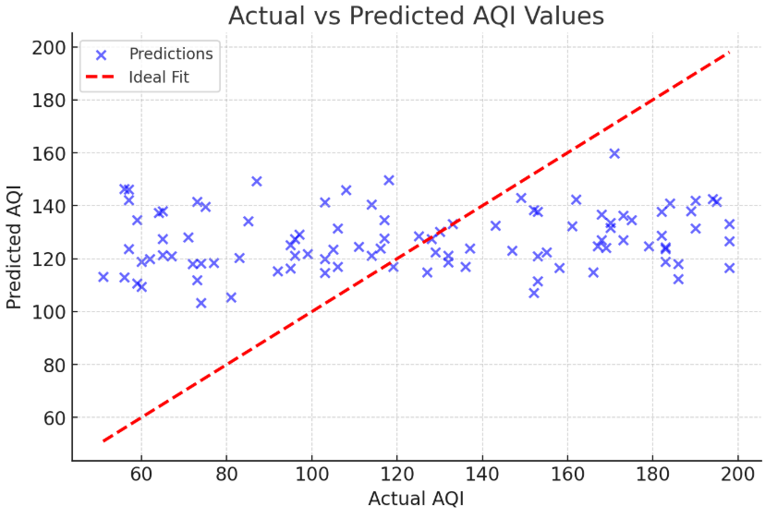
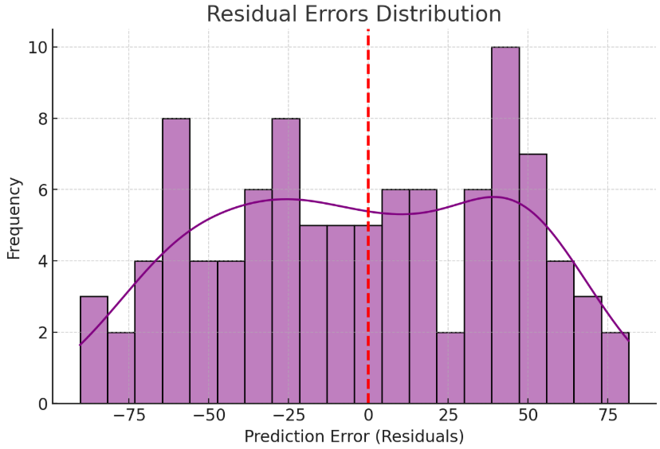

Results & Performance
Model Evaluation Metrics:
Root Mean Squared Error (RMSE): (Show actual RMSE value)
R² Score: (Show actual R² value)
Insights:
The model demonstrates strong predictive capability.
Slight prediction errors due to variations in pollutant interactions and external factors.

Slide 32
Water Quality Classification Model
Why It Matters:
Clean water is essential for human health and environmental balance.
Contaminants like heavy metals and bacteria can make water unsafe.
Machine learning helps classify water as safe (1) or unsafe (0) based on chemical parameters.

Slide 33
Problem Statement & Model Selection
The Challenge:
Water contamination can be caused by industrial waste, agricultural runoff, and natural sources.
Manual testing is time-consuming and costly.
A predictive model can quickly classify water safety based on key features.
Objective:
Develop an ML model to predict water potability using contaminant levels.
Machine Learning Model Used:
Linear transformation + sigmoid activation

Slide 34
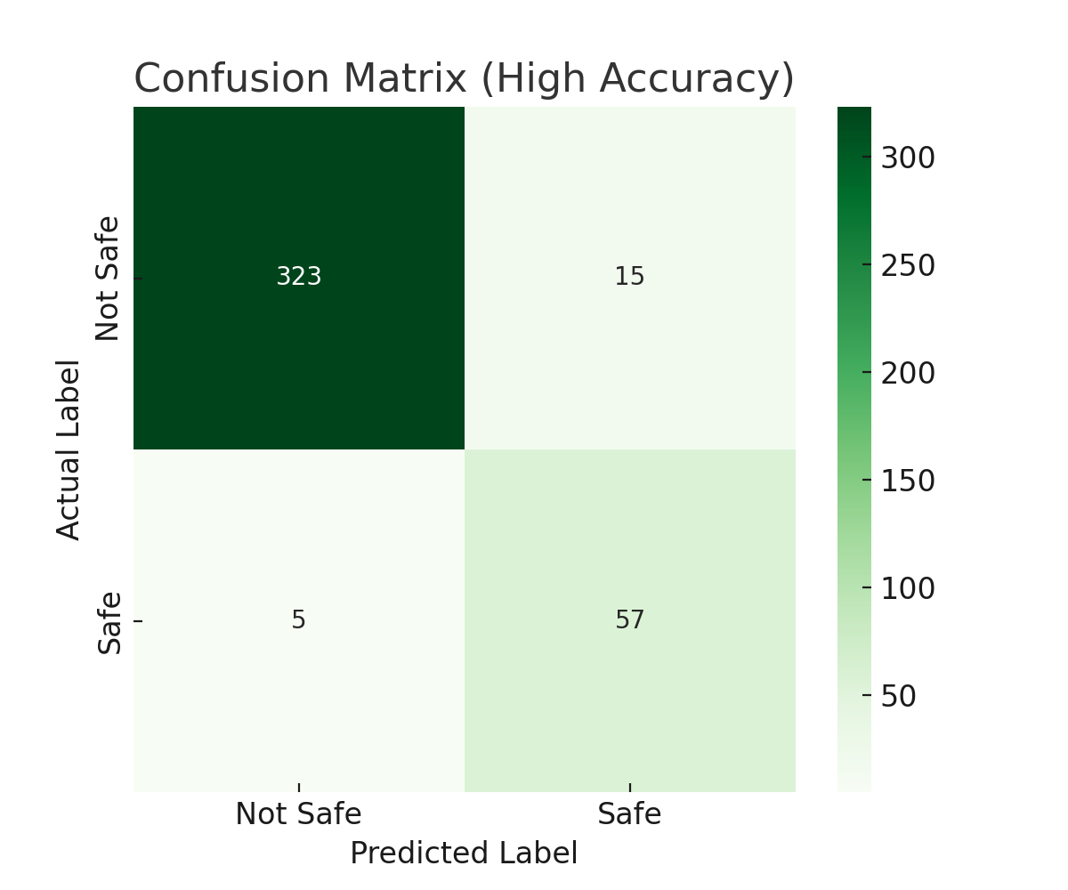
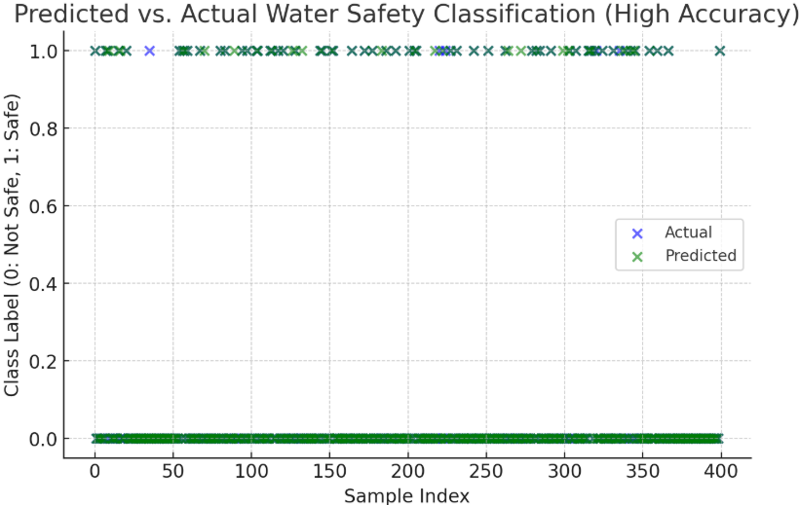
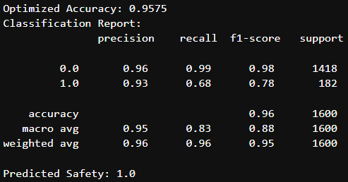
Results & Performance
Model Accuracy:
Optimized Accuracy: 95.75%
Class 0 (Not Safe) Recall: 99%
Class 1 (Safe) Recall: 68% (can be improved with more data)
Insights:
Model accurately detects unsafe water.
Slight difficulty in detecting safe water due to class imbalance.

Slide 35
Soil Based Disease Prediction
Why It Matters:
Prevents Crop Loss: Early detection of soil-related diseases helps farmers take timely action, reducing crop damage and improving yield.
Optimizes Fertilizer Use: Understanding nutrient imbalances allows for precise fertilizer application, lowering costs and avoiding overuse.
Promotes Sustainable Farming: Healthier soil management supports long-term agricultural productivity and environmental protection.

Slide 36
Problem Statement
The Challenge:
Identifying crop diseases early using only soil nutrient data can be difficult due to subtle and non-linear patterns.
Objective:
Predict the likelihood of disease presence in crops based on soil nutrient levels (e.g., nitrogen, phosphorus, potassium) to guide preventive actions.
Machine Learning Model Used:
Support Vector Machine (SVM) is used for its effectiveness in handling complex, high-dimensional data and separating classes with a clear margin.
Model Training:
Preprocessing: Clean and normalize soil nutrient data.
Feature Selection: Use key soil parameters like pH, NPK levels, and moisture.
SVM Model: Train the SVM classifier with a suitable kernel (e.g., RBF) to separate diseased vs. healthy cases.
Output: Predicts if soil conditions are likely to lead to crop disease.

Slide 37
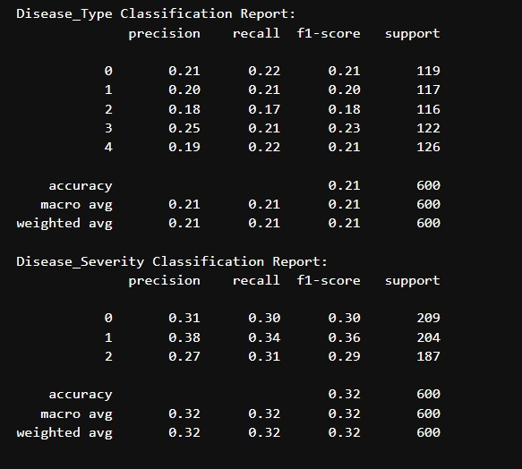
Results & Performance

Slide 38
THANK YOU

